Slide 1
Pedestal Calibration
Overview

Slide 2
Purpose
The Tool
This Presentation
Pedestal Calibration (PedCal) is a new routine in System Test Software (build 17 or greater) that should not be run unless directed by a troubleshooting procedure or fault note
This presentation provides a description and demonstration of PedCal to help familiarize you with how the tool works.

Slide 3
Disclaimer
This presentation is not intended to supersede or substitute for the information found within the WSR-88D Electronic Handbooks.
The technician should always read new revisions and change packages, to better understand any changes to their system, or the maintenance procedures prior to the development of an issue.
The information in this slideshow is based on EHB 6-513 Revision 0 and 6-513-1 Revision 0 dated 1 August 2016.
The screenshots are representative of a non-operational training system, running software build 17.1.

Slide 4
Pedestal Calibration
Pedestal Calibration (PedCal) is not recommended for use as a troubleshooting tool.
It does not replace the old DCU gain and offset alignments, the SPIP will adjust voltage as required.
What it is…
What it isn’t…
A tool that calibrates the control software to the sites pedestal.
It should only be run as a result of following troubleshooting procedures or fault notes
So what does Pedestal Calibration do then?
Notes:
The RSP’s built in (Visalia) software can work with any number of pedestal designs, It uses an internal “model” that must be turned to match our pedestals performance.

Slide 5
What it does…
Pedestal Calibration determines pedestal performance values for Feedback, Friction and Slope in both axes and for Droop in Elevation axis. This tunes the control software’s antenna model to match the actual performance of the site’s pedestal.
These values assist in getting the antenna to a requested velocity and/or position without excessive over/undershoot and maintain a constant velocity/position (with minimal dither around the requested value).
This calibration can be run from the MSCF.

Slide 6
Caution
It is strongly advised to create a back-up of the system before running Ped Cal.
Performing backups with the removable drive on the RSP takes less than 5 seconds and allows the technician to quickly restore their adaptation data if the calibration does not cause an improvement.

Slide 7
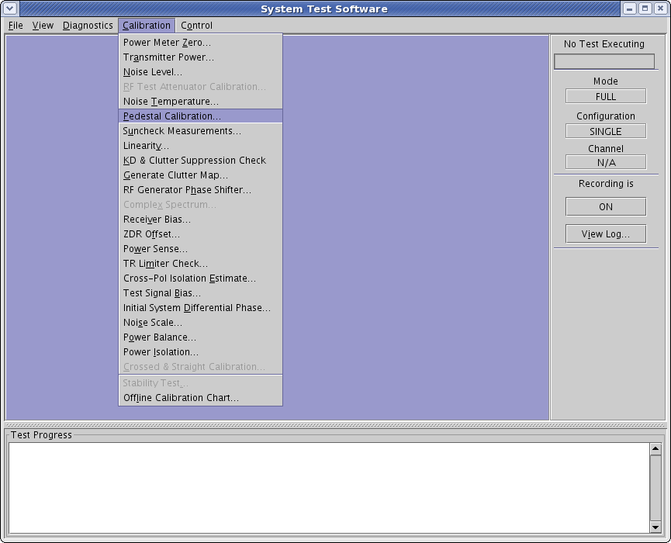
STS Menu
Notes:
Pedestal Calibration is a new calibration routine in System Test Software on build 17 or later software.

Slide 8
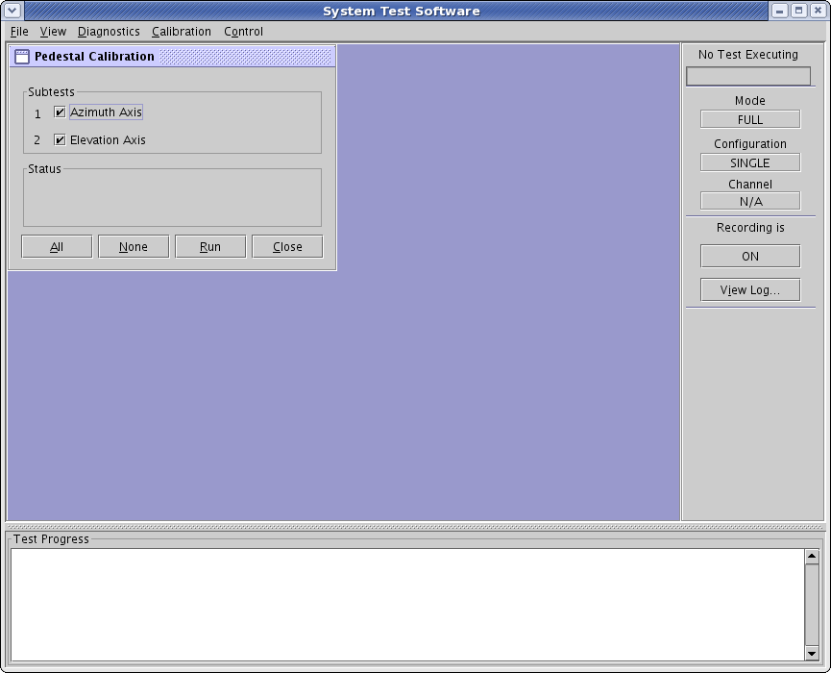

PedCal Menu
Notes:
The calibration routine executes two subtests: Azimuth Axis and Elevation Axis.
By default both subtests are selected.
Either subtest can be deselected to run individually; when run together Azimuth Axis tests will run first.
Azimuth testing consists of the following types of adjustments: Feedback, Friction, Slope, and Adjustment.
Elevation has additional tests required for position slope tuning.
The type of measurement a subtest is performing will be displayed in the Status area.

Slide 9

Azimuth Feedback Test (1 of 3)
Notes:
First the Azimuth Feedback Test determines an initial value for the velocity feedback slope by commanding a change in position and assesses: 1) if the antenna made it to the requested position, 2) if "overshoot" is within limits, and 3) if we are dithering after we get to the final position.

Slide 10
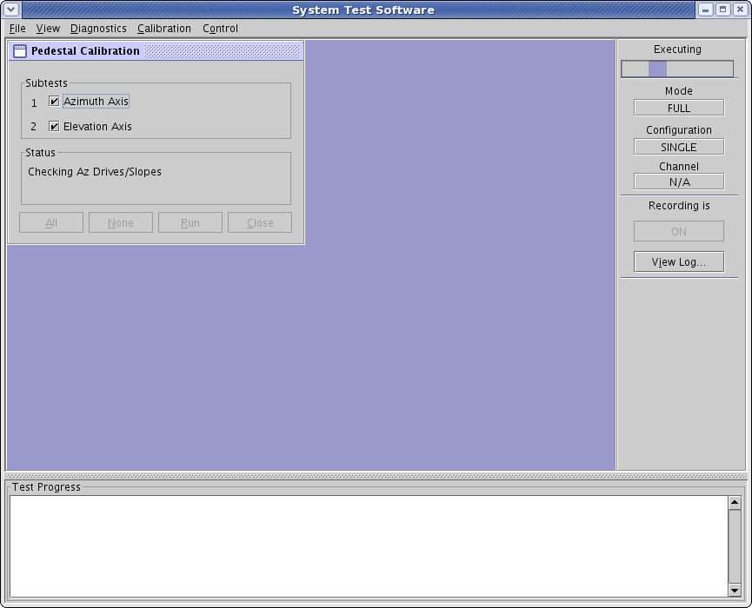
Checking Az Drives/Slopes
Notes:
Az Drives/Slopes adjusts for Friction and Slope.
- Friction estimates the minimum drive needed to sustain the pedestal in motion against friction, both forward and backward.
- Slope adjusts the amount of additional drive voltage needed for changes in rate (velocity).

Slide 11

Updating Az Feedback Test (2 of 3)
Notes:
After Drive and Slope estimates are made, Feedback is reevaluated using the new Drive/Slope values and the feedback estimate is updated.

Slide 12

Adjusting Az Drives/Slopes
Notes:
After Feedback is adjusted, Drives/Slopes are fine tuned.

Slide 13

Running Az Feedback Test (3 of 3)
Notes:
With the latest drives/slopes, the feedback is adjusted a third time.

Slide 14

Running Az Feedback Diagnostic
Notes:
A test of the Feedback parameters is run. The Antenna is moved using the final Drive, Slope and Feedback values, and the results are analyzed. If the test passes (minimal over/undershoot, minimal dithering, reaches position within expectations) the routine will proceed on to determining the antenna’s elevation parameters. Otherwise, the routine will continue to a diagnostic for fine tuning (next slide).

Slide 15

Az Feedback Diagnosis Subtest 1 of 7
Notes:
This sub-routine will fine tune Feedback using seven different values offset from the final value determined by the previous routine. At it’s conclusion the best performing feedback parameters will be selected to update adaptation data.
There are seven subtests, one for each of the offset values. Each test will take about one minute. (slides will auto-advance more quickly)

Slide 16

2 of 7

Slide 17

3 of 7

Slide 18

4 of 7

Slide 19

5 of 7

Slide 20

6 of 7

Slide 21

7 of 7
Notes:
After the Az Diagnostic Test, the Elevation routines will start if they have been selected

Slide 22

Checking El Droop Settings
Notes:
El Droop Settings determines the antenna balance in the servo loops. This determines how much drive is needed to maintain certain elevation positions.
It evaluates droop at several elevation positions and finds settings that works well enough for all of the positions.

Slide 23

Checking El Drives/Slopes
Notes:
Just as in Azimuth, the Elevation Drives/Slopes adjusts for Friction and Slope.
The Friction portion of the test estimates the minimum drive needed to sustain the pedestal in motion against friction, both up and down.
The Slope portion of the test adjusts the amount of extra drive voltage needed for the pedestal to move at operational rates.

Slide 24

Running Initial El Feedback Test (1 of 3)
Notes:
Initial Feedback determines an initial value for the velocity feedback slope. The routine commands a change in position and assesses: 1) if the antenna made it to the requested position, 2) if "overshoot" is within limits, and 3) if we are dithering after we get to the final position.

Slide 25

Adjusting El Drives/Slopes
Notes:
Drive and Slope are tested again with the initial estimate for Feedback

Slide 26

Updating El Feedback (2/3)
Notes:
Feedback is checked using the updated Drive/Slope values

Slide 27

Running El Pservo Slope Test
Notes:
Just as with the old DCU, elevation is controlled in operation by position commands, servo drive is all about rates.
Pservo Slope determines how much drive is needed to go a specific distance in a certain amount of time. To meet VCP requirements, our system needs to make a 1 deg position jump within 0.6 seconds and go from 19.5 to 0.5 within 2.3 seconds.
Pservo Slope Test will command the pedestal to move between three different intervals (1.0°, 5.7°, and 19.0°). If the requirements are met no further tests are needed. If additional adjustment is indicated, additional subtests for each Pservo Slope will appear on screen.

Slide 28

Updating El Feedback (3 of 3)
Notes:
Just like in Az, Feedback will be evaluated and the estimate updated after each adjustment to the control loops.

Slide 29

Running El Feedback Diagnostic
Notes:
Then the estimate will be tested. Once again if the test results are not within expected tolerances; additional subtests will run. (next 7 slides).

Slide 30

El Feedback Diagnosis Subtest 1 of 7
Notes:
If testing determined a need to fine tune the Feedback parameters; seven different offsets will be applied, and the best results will be used in the final results. (the next few slides will auto-advance more quickly)

Slide 31

2 of 7

Slide 32

3 of 7

Slide 33

4 of 7

Slide 34

5 of 7

Slide 35

6 of 7

Slide 36

7 of 7

Slide 37
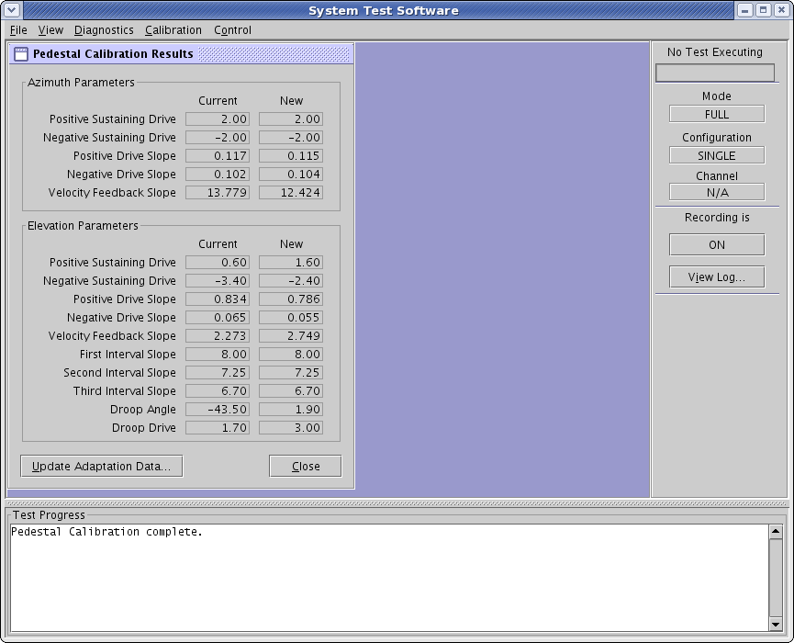
Pedestal Calibration Results
Notes:
Approximately 10 to 27 minutes after starting, the pedestal calibration completes and will display the current and new results.
If the results look reasonable, and the test was run as a result of antenna alarms, update the results, restore to service and monitor the system to see if it completes a VCP without alarms.
We will address what are acceptable numbers after we conclude the test.

Slide 38
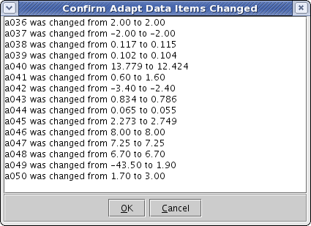
Confirm Adapt Data Items Changed
Notes:
Accept updates

Slide 39
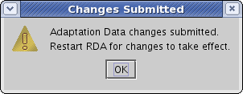
Changes Submitted
Notes:
Click OK

Slide 40
Close PedCal Results
Notes:
Click Close to advance slide

Slide 41
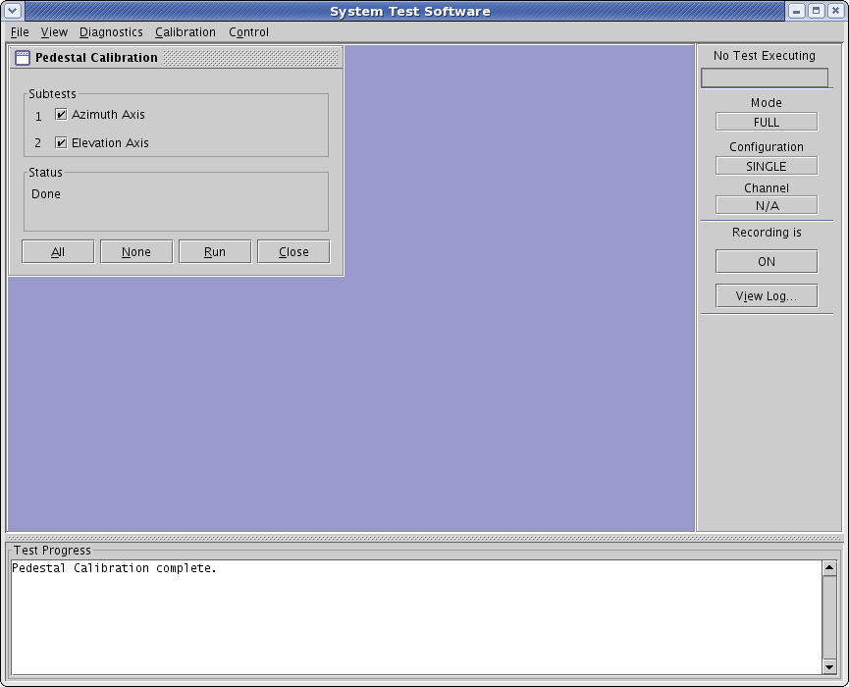
Close PedCal
Notes:
(remember to restart RDASC software)

Slide 42
Main STS Window
Notes:
For Troubleshooting refer to NWS EHB 6-513, Fault Note 37

Slide 43
Lets take a look at those numbers…

Slide 44
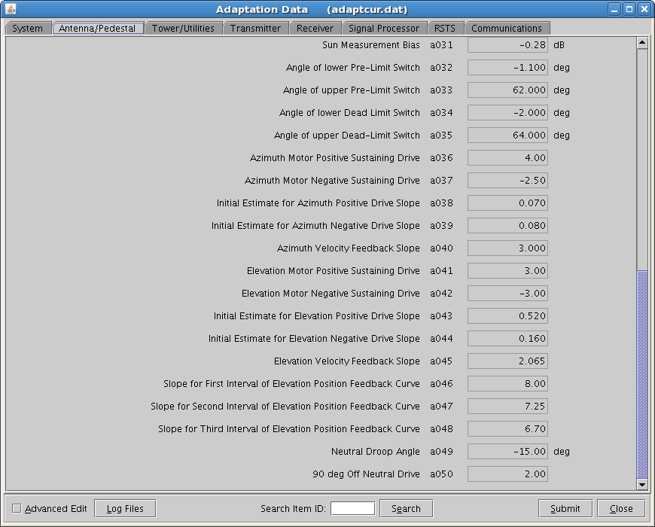
Adaptation Data: a036-a050
Notes:
Pedestal Calibration will update Adaptation data for a036 through a050. Do not manually edit the adaptation data as a misplaced decimal could cause the pedestal to exceed it’s design parameters, resulting in catastrophic failure.

Slide 45
Servo Control Loop
ELEVATION DROOP DRIVE
ENCODER DATA
ANTENNA MODEL FILTER AND DIFFERENTIATE
TACHOMETER VOLTAGE
ANTENNA MODEL CURRENT POSITION
CURRENT VELOCITY
DRIVE SLOPE BREAK POINTS
CALCULATE VELOCITY COMMAND
POSITION COMMAND
AT VELOCITY?
VELOCITY COMMAND
YES
NO
FRICTION FEEDBACK DRIVE SLOPE
CALCULATE NEW DRIVE VOLTAGE
DRIVE VOLTAGE
Notes:
Pedestal Calibration determines Friction, Feedback, and Drive Slope for Azimuth and Elevation, Drive Slope Break Points, and the Elevation Droop Drive
The Encoder provides Position Data to the Antenna Model.
The Servo Motor Tachometer Feedback is available, but is not used. Instead the Antenna Model derives a Virtual Tachometer from encoder position data.
Servo Drive Voltage is Velocity based.

Slide 46
Servo Control Loop
ELEVATION DROOP DRIVE
ENCODER DATA
ANTENNA MODEL FILTER AND DIFFERENTIATE
TACHOMETER VOLTAGE
ANTENNA MODEL CURRENT POSITION
CURRENT VELOCITY
DRIVE SLOPE BREAK POINTS
CALCULATE VELOCITY COMMAND
POSITION COMMAND
AT VELOCITY?
VELOCITY COMMAND
YES
NO
FRICTION FEEDBACK DRIVE SLOPE
CALCULATE NEW DRIVE VOLTAGE
DRIVE VOLTAGE
Notes:
Pedestal Calibration determines Friction, Feedback, and Drive Slope for Azimuth and Elevation, Drive Slope Break Points, and the Elevation Droop Drive

Slide 47
Servo Control Loop
ELEVATION DROOP DRIVE
ENCODER DATA
ANTENNA MODEL FILTER AND DIFFERENTIATE
TACHOMETER VOLTAGE
Virtual Tachometer
ANTENNA MODEL CURRENT POSITION
CURRENT VELOCITY
DRIVE SLOPE BREAK POINTS
CALCULATE VELOCITY COMMAND
POSITION COMMAND
AT VELOCITY?
VELOCITY COMMAND
YES
NO
FRICTION FEEDBACK DRIVE SLOPE
CALCULATE NEW DRIVE VOLTAGE
DRIVE VOLTAGE
Notes:
The Encoder provides Position Data to the Antenna Model.
The Servo Motor Tachometer Feedback is available, but is not used. Instead the Antenna Model derives a Virtual Tachometer from encoder position data.
Servo Drive Voltage is Velocity based.

Slide 48
Servo Control Loop
ELEVATION DROOP DRIVE
ENCODER DATA
ANTENNA MODEL FILTER AND DIFFERENTIATE
TACHOMETER VOLTAGE
Virtual Tachometer
ANTENNA MODEL CURRENT POSITION
CURRENT VELOCITY
DRIVE SLOPE BREAK POINTS
CALCULATE VELOCITY COMMAND
POSITION COMMAND
AT VELOCITY?
VELOCITY COMMAND
YES
NO
FRICTION FEEDBACK DRIVE SLOPE
CALCULATE NEW DRIVE VOLTAGE
DRIVE VOLTAGE
Notes:
In the Velocity Loop the Commanded Velocity is compared to the Current Velocity and a rate is calculated using the antenna’s El and Az Friction, Feedback, and Drive Slope parameters.

Slide 49
Servo Control Loop
ELEVATION DROOP DRIVE
ENCODER DATA
ANTENNA MODEL FILTER AND DIFFERENTIATE
TACHOMETER VOLTAGE
Virtual Tachometer
ANTENNA MODEL CURRENT POSITION
CURRENT VELOCITY
DRIVE SLOPE BREAK POINTS
CALCULATE VELOCITY COMMAND
POSITION COMMAND
AT VELOCITY?
VELOCITY COMMAND
YES
NO
FRICTION FEEDBACK DRIVE SLOPE
CALCULATE NEW DRIVE VOLTAGE
DRIVE VOLTAGE
Notes:
In the Position Loop the Commanded Position is compared to the Antenna Model’s Current Position and the difference is modified by the Drive Slope Break Points to create a rate command (basically, the Drive Slope Break Points convert a position error into the rates necessary to travel the desired distance – the greater the distance - the higher the rate, as the position error decreases - the rate also decreases).
Elevation drive is modified by the parameter for Elevation Droop Drive to hold the antenna at the requested elevation.

Slide 50
Results
Do not expect exact same output numbers each time PedCal is executed.
Resulting numbers can be different before/after and still work well for the antenna
  If running a VCP generates no alarms, errors, or unexpected motion, then the numbers are good
Slightly different rotation rates, drive amounts, and momentum can result in different responses each time

Slide 51
Acceptable Numbers
Sustaining Drives should not change much, if at all after the initial calibration at INCO (<0.1 to 3 units).
Notes:
What are “Good” numbers.
It’s hard to say at this point, more guidance will come out as more systems come on-line and more data is collected for evaluation.
The general rule of thumb is that the numbers are good if the radar completes a VCP without alarms.
What we expect is…
Click through the animations for details.

Slide 52
Acceptable Numbers
Drive Slopes will change, but should not change by much (<0.1 to 2 units).
Notes:
What are “Good” numbers.
It’s hard to say at this point, more guidance will come out as more systems come on-line and more data is collected for evaluation.
The general rule of thumb is that the numbers are good if the radar completes a VCP without alarms.
What we expect is…
Click through the animations for details.

Slide 53
Acceptable Numbers
Feedback will change quite a bit from calibration to calibration, (<0.1 to 3 units) and should not be cause for alarm, unless the changes are large (>6 units). Changes that are greater than 6 units most likely indicate mechanical issues.
Notes:
What are “Good” numbers.
It’s hard to say at this point, more guidance will come out as more systems come on-line and more data is collected for evaluation.
The general rule of thumb is that the numbers are good if the radar completes a VCP without alarms.
What we expect is…
Click through the animations for details.

Slide 54
Acceptable Numbers
1st 2nd and 3rd Interval Slopes will only update if Pservo Slope Test runs additional subtests. Expected range is:
1st Interval: <0.1 to 7.0 units
2nd Interval: <0.1 to 5 units
3rd Interval: <0.1 to 4 units
Notes:
What are “Good” numbers.
It’s hard to say at this point, more guidance will come out as more systems come on-line and more data is collected for evaluation.
The general rule of thumb is that the numbers are good if the radar completes a VCP without alarms.
What we expect is…
Click through the animations for details.

Slide 55
Acceptable Numbers
From calibration to calibration
Droop Angle and Drive numbers
may change significantly, but the
effect on the system will still be
the same.
D_{offset} = D_{sus} + D_{droop} * sin(Position – Angle_{droop})
Many combinations of D_{droop} and Angle_{droop}
give the same D_{offset}
i.e. 5=3+2 and 5=-9+14
Notes:
What are “Good” numbers.
It’s hard to say at this point, more guidance will come out as more systems come on-line and more data is collected for evaluation.
The general rule of thumb is that the numbers are good if the radar completes a VCP without alarms.
What we expect is…
Click through the animations for details.

Slide 56
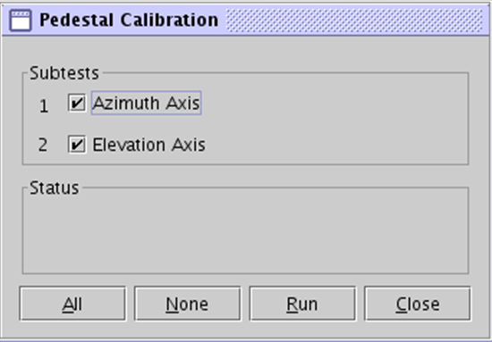
Options for suspicious results…
Don’t accept the new numbers, and re-run the calibration testing only the Axis that gave suspicious numbers
Don’t accept the numbers, assess possible hardware issues, and rerun PedCal
  If the numbers look about the same as before the hardware degraded, life is good.
Accept the new numbers and run a VCP to see if alarms are generated
  Even with a large change the numbers are probably correct for the pedestal at that time
  If you do get alarms, you can always go back to your old adaptation data.
  If values are updated with bad hardware, the system will run until the hardware fails, possibly better than it was running before the calibration. When the hardware is replaced, you will have to re-run the calibration.

Slide 57
Pedestal Calibration will fail if…
  …the pedestal moved or failed to move in a way that caused the antenna library to enter a “safe” state (error message: RCP Shutdown will be displayed).
  For example, lower elevation limit, velocity tolerance exceeded, etc.
A
- or -
  …certain hardware alarms are encountered (e.g., Power Amp alarms)
B

Slide 58
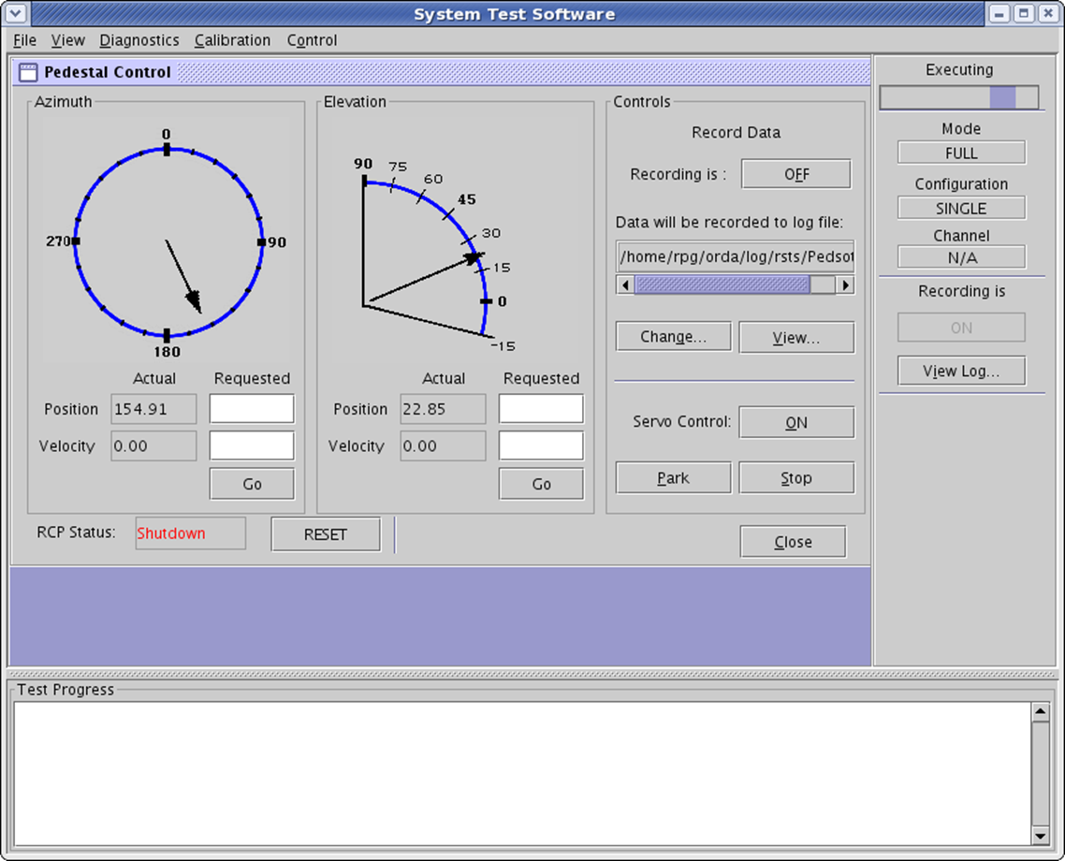
Radar Control Process (RCP) Shutdown
RCP Shutdown means the antenna driver has entered a “safe” state. The control loop will not issue any further commands until it is told to reset.
RCP Shutdown is usually caused by conditions that will generate alarms. There may be additional actions to consider before resetting.
Restart RCP by going to Pedestal Control (STS > Control > Pedestal Control) and clicking the “Reset” Button
Notes:
RCP Shutdown means the antenna driver has entered a “safe” state. The control loop will not issue any further commands until it is told to reset.
RCP Shutdown is usually caused by conditions that will generate an alarm. In other words, there may be additional conditions to consider before resetting.
Be sure to evaluate all situations to avoid further damage prior to resetting.
Recover by going to Pedestal Control (STS > Control > Pedestal Control) and clicking the “Reset” Button

